Slide 1

Social Psychology- Nature and Scope
Dr J Balamurugan

Slide 2
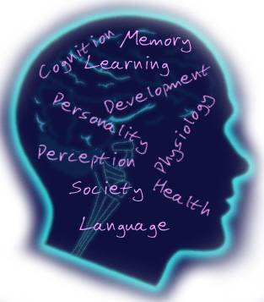
Social Psychology
Social psychology is the scientific field which seeks to understand the nature and causes of social behaviour.

Slide 3
Introduction
An individual can be a member of more than one group of many societies, clubs, institutions, associations etc.,
This complexity of an individual’s membership to various forms of social groupings have raised many typical problems for the individual himself and for the social groupings of which he becomes a member.
To understand the man’s conduct in his interaction with the various forms of groupings it is essential, that we can study under the social psychology.

Slide 4
Cont…
Human being constantly interact with each other by sharing their experiences and emotions.
They are deeply influenced by various social forces – the culture, beliefs, values and attitudes.
Government administrators, heads of labour and industry, cultural and religious leaders, military leaders etc. are ready to seek the help of the social psychologists in an attempt to deal with problems of human relations, group effectiveness, and conflicts among people.

Slide 5
Definitions
Kimball Young says, “Social Psychology is the study of persons in their interactions with one another and with reference to the effects of this interplay upon the individual’s thoughts, feelings, emotions and habits”.
Krech and Crutchfield consider that “social psychology is the only science of society which is concerned with every aspect of the individual’s behavior in society.”
Another definition, “Social Psychology is the study of the way in which individuals are affected by social situation.”

Slide 6
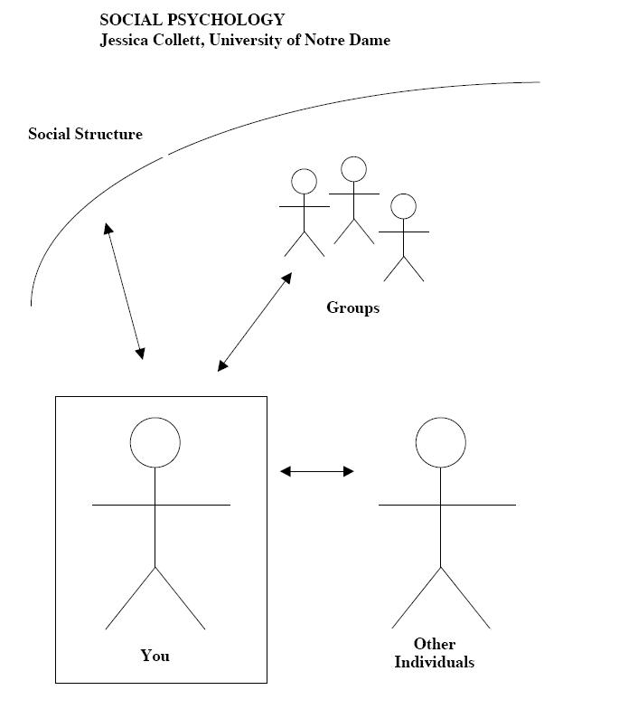
Definitions

Slide 7
Psychological and Sociological forms of Social Psychology
Psychological - social psychology focuses on the cognitive structures and processes of individuals in society.
Sociological - social psychology emphasizes the determining function of social systems, social institutions and social groups for individual behaviour.

Slide 8

Need of Social Psychology
To build a society of healthy, happy and peace-loving people.
To understand man and his behaviour in the social context.
To help individual how to live with himself, not as an isolated individual, but as a social entity.
The major aim of social psychologists is to understand the variety of social forces and factors that affect the actions of individuals in a wide range of social settings.

Slide 9
Nature of Social Psychology
Social Psychology focuses on the behaviour of individuals
it is concerned with the behaviour and thoughts of individuals, rather it not focuses on large groups of persons or society as a whole.
For example, in the topic of violent crime, Social Psychologists focus on the factors that cause specific persons to engage in such behaviour

Slide 10
Nature of Social Psychology
Social Psychology is study of the nature and causes of social behaviour and thought
Social psychologists basically interested in understanding the factors and conditions that shape the social behaviour and thought of individuals – their actions, feelings, beliefs, memories and inferences concerning the other persons.
A huge number of variables play a role in this regard.

Slide 11
Nature of Social Psychology
Social Psychology is scientific in nature because it adopts the values and methods used in other fields of science.
Social Psychologists adopt the scientific method because “common sense” provides an unreliable guide to social behaviour.

Slide 12
Scope of Social Psychology
Socialization of the Child
Social Motivation
Attitudes and their Measurement
Social Interaction
Social Perception
Social Learning
Culture and Personality
Language and Communication

Slide 13
Social psychology and related disciplines

Slide 14
Social psychology and general psychology
The social psychology is quite intimately related with the general psychology.
General psychology makes a study of the individual behaviour. It studies the individual without making any reference to the social environment.
On the other hand, social psychology studies the social behaviour of the individual.
The identity between general psychology and social psychology is on account of the fact that both must make a study of the behaviour of an individual as a social being.
We cannot make study of the behaviour of an individual without taking into consider the social setting in which he is placed.

Slide 15
Social psychology and sociology
Social psychology has also very intimate relationship with sociology.
Sociology makes a study of the social group.
This subject of Sociology makes a scientific study of social organisation and group behaviour as distinct from the behaviour of the individuals in the social group.
It studies how the groups are organized and what are their structures.
Thus, it is more or less concerned with the study of the group in its various aspects.
The social psychology also makes study of the groups with respect to the behaviour of the individuals in them.
Thus, both the sciences study the group but from different angles.

Slide 16
Social Psychology and Economics
Economics deals with earning and spending of money. This science makes a study of productivity, trade, distribution of money etc.
The productivity, the trade, the home economics, the expenditure, the currency, the inflation and the deflation are all dependent on the individual’s behaviour.
When men labour hard and work in co-operation then the productivity is higher, on the other productivity diminishes when there is discontent.
If you do not pay attention to the individuals behaviour then all the laws of economics are of no value.
As a matter of fact, laws of economics are framed with reference to the individual’s living in the society.
The social psychology also deals with the individual’s living in the society. Thus, each of these sciences influence each other.

Slide 17
Social psychology and anthropology
The social psychology is also quite closely related with anthropology.
According to Wissler, the psychology studies the behaviour of the individual while cultural anthropology studies group behaviour.
The cultural anthropology when it makes a study of different cultures, clearly informs us that human beings differ in their outlooks in different cultures.
The understanding of the individual bahviour as a whole in different cultures we easily enter from the field of cultural anthropology to the field of social psychology.

Slide 18
Social Psychology and Political Science
Political science is mainly concerned with the Administration and Government of different nations. It studies the constitutions of countries. It probes into the nature of the Government.
It deals with the rights and duties of the citizens.
The political science studies the group activities which deal with the formation of laws and organisation of Government.
While the social psychology studies aspect of the individual behaviour in the society.
Many of the problems of social psychology and political science are common.

Slide 19
Social Psychology and Abnormal Psychology
The social psychology depends to a very great extent on abnormal psychology for understanding the abnormal or anti-social behaviour individuals.
The abnormal behaviour of the individual, many a times, is a consequence of brain injury, alcoholism, syphilis and diseases.
Thus, if one individual behaves in an abnormal or anti-social manner then the real cause of his such behaviour can be found with the help of social psychology.
The study of social psychology is also helpful in the study d abnormal psychology.

Slide 20
Social Psychology and Ethics
Ethics is a normative science.
It is a science which deals with the order and control of the individual behaviour.
Psychology is on the other hand, a science which studies the behaviour as it is.
The ethics forms the norms pertaining to good or bad behaviour.
How these norms affect the individual behaviour in society is the subject matter of social psychology.
Thus, we can clearly see the dependence of one on the other.

Slide 21
Social psychology and Biology
Biology and Physiology are also related to Social Psychology.
Biology studies heredity.
It also tells us how an organism develops from a tiny embryo to a full grown up individual. It gives us the details of the beginning of life.
After the birth of the child two forces govern his social behaviour, the heredity and the environment.
His behaviour in the environment is studied by social psychology.

Slide 22
Thank you

